Slide 1


Zatoichi Ghost
Assignment 03 Task 5 Made by Group 27

Slide 2
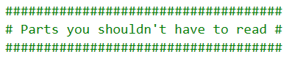
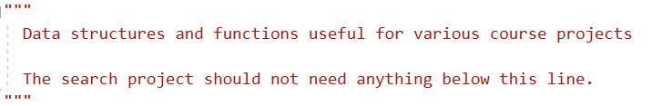
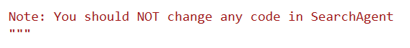
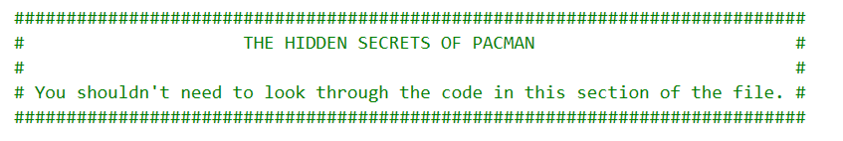
Process
We modified a bunch of things we shouldn’t have

Slide 3
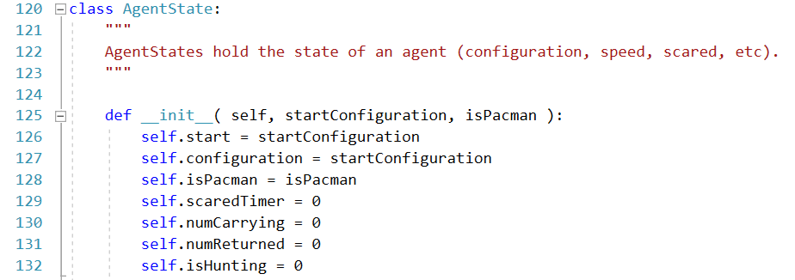
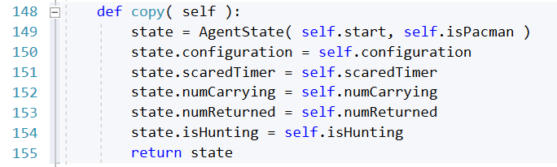
Additional State Ghosts
(Game.py)
Notes:
We added isHunting

Slide 4
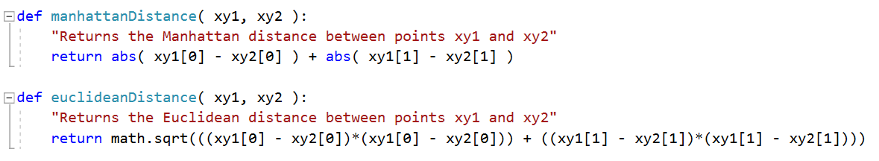
Ghost decision calculation – Part a
(util.py)
Notes:
Added Euclidean distance
Replaced manhatten dist.
Always attacking

Slide 5
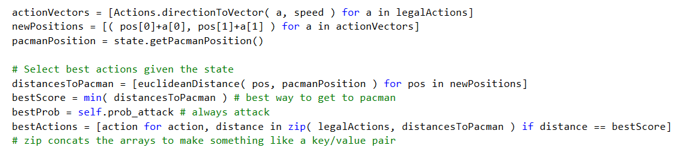
Ghost decision calculation – Part b
(ghostAgents.py)
Notes:
Added Euclidean distance
Replaced manhatten dist.
Always attacking
Best prob is .999 bc 1 broke it

Slide 6
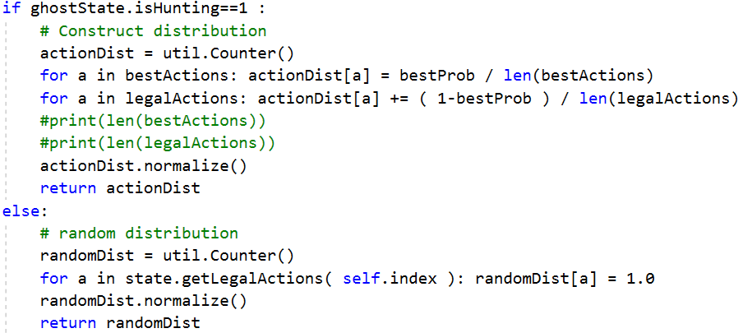
Ghost choice
(ghostAgents.py)
Notes:
Modified version of directional & random ghost
Not scared ghost

Slide 7
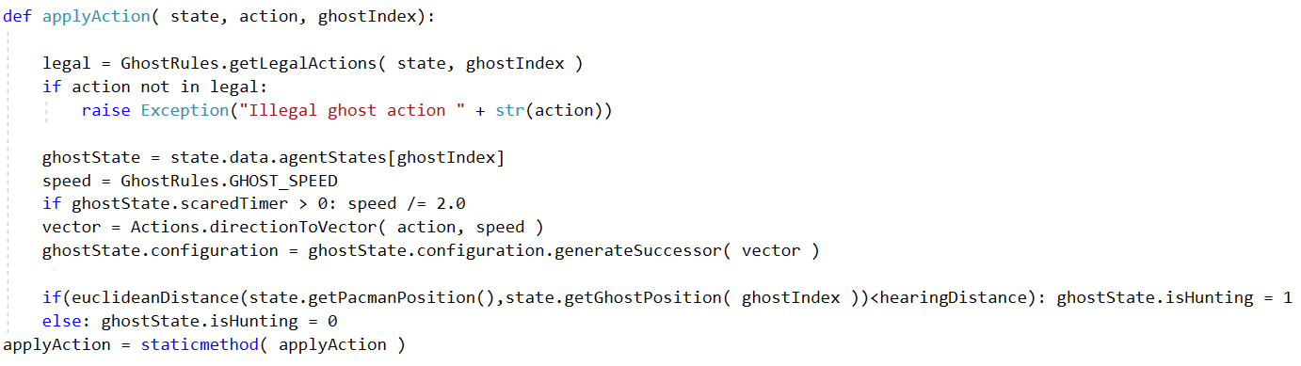
Ghost decision execution
(Pacman.py)
Notes:
Code added:
- Last if / else -> interacts with isHunting &

Slide 8
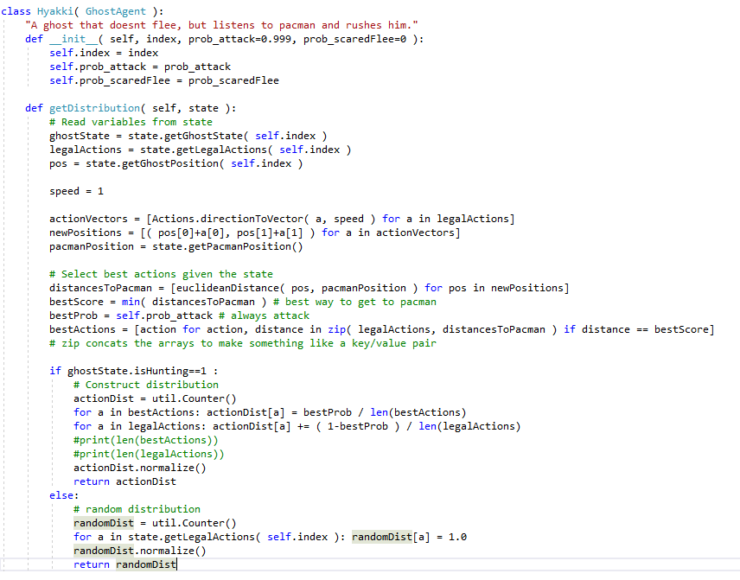
In conclusion: The Ghost controller
(ghostAgents.py)
Notes:
Modified random ghost & directional ghost

Slide 9
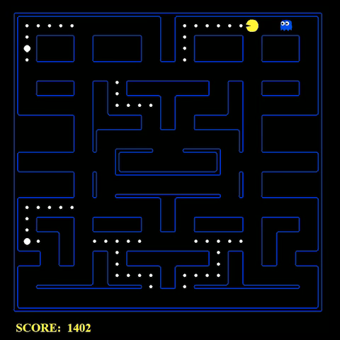
Thank you for your attention!

